Slide 1
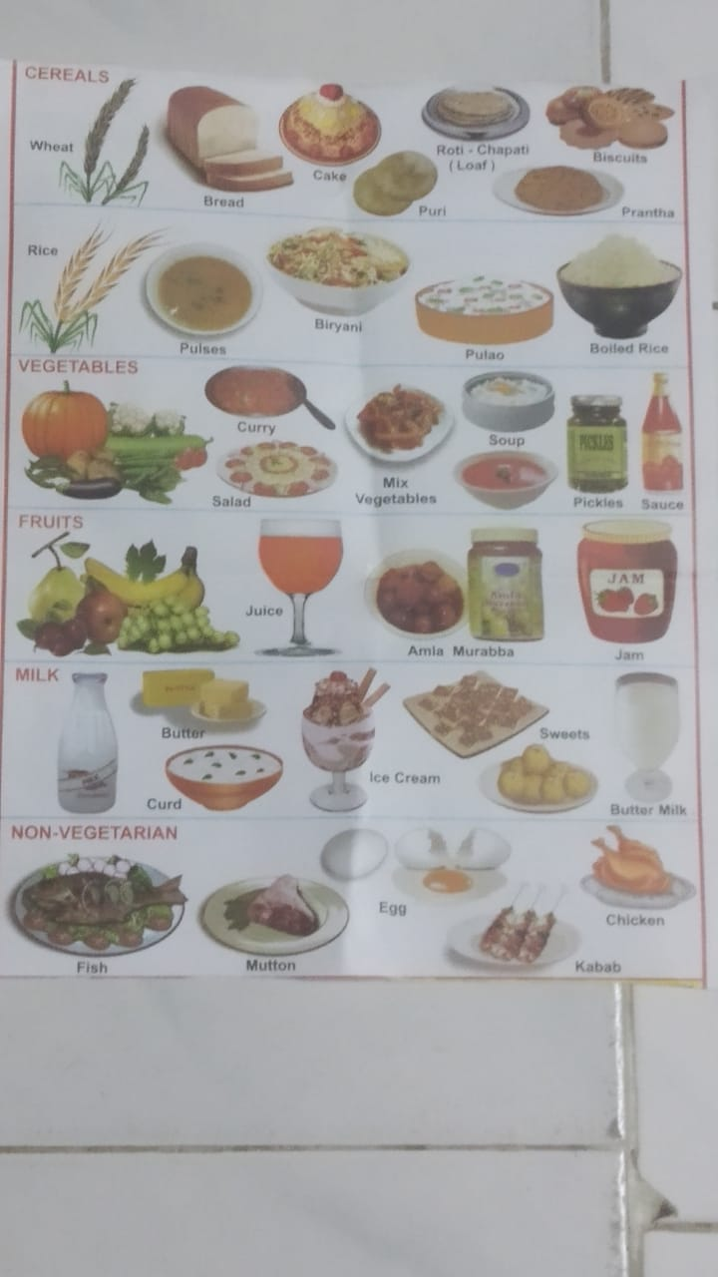
Health Is Everything
1.)ALL SHOULD TAKE HEALTHY AND HYGIENE FOOD.
HEALTHY FOOD MAKES STRONG AND PRTECTS US FROM VARIOUS DISEASES.

Slide 2
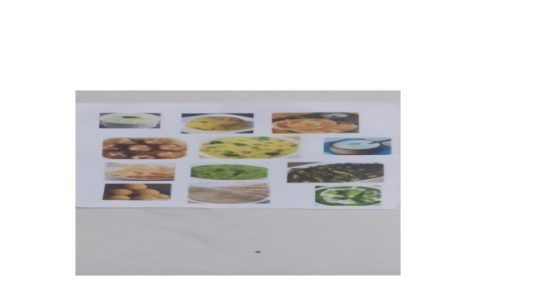

Slide 3
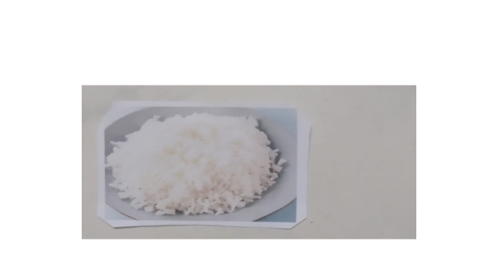

Slide 4


Slide 5

2.)EVERYONE SHOULD DO EXERCISE REGULARALY. EXERCISE MAKES OUR BODY FIT AND STRONG.

Slide 6


Slide 7


Slide 8

3.)EVRYONE SHOULD DO YAGA AND MEDITATION. IT INCREASES OXYGEN LEVEL AND INCREASES LIFE SPAM.

Slide 9


Slide 10


Slide 11

4.)EVERYONE SHOULD DO THEIR REGULAR ACTIVITIES ON TME. IT KEEPS THE BODY AND MIND FFRESH AND ACTIVE.

Slide 12


Slide 13


